Slide 1
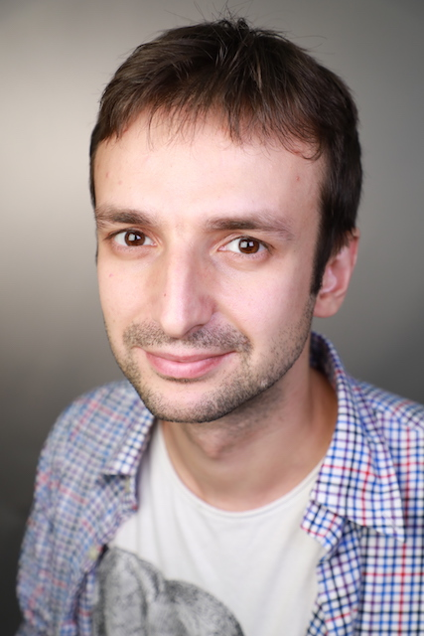


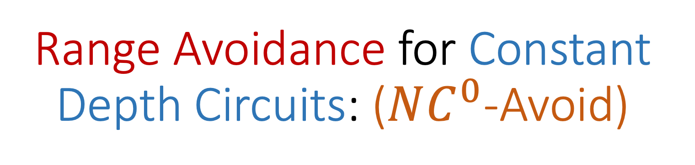
Range Avoidance for Constant Depth Circuits: ($NC^{0}$-Avoid)
Karthik Gajulapalli (Georgetown)
Sasha Golovnev
Satyajeet Nagargoje
Sidhant Saraogi

Slide 2


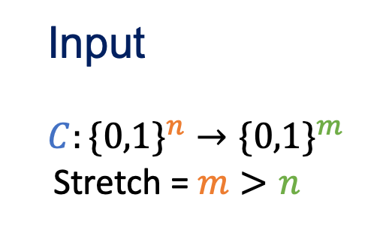
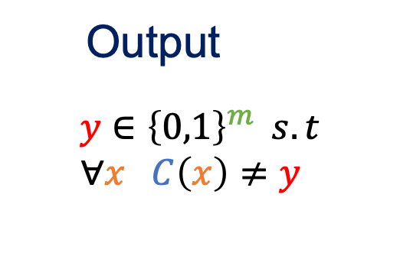
Range Avoidance Problem
Kleinberg, Korten, Mitropolsky, Papadimitriou [ITCS 2021]
$$\{0,1\}^{m}$$
Output
$$y∈{\left\{0,1\right\}}^{m} s.t$$
$∀x C\left(x\right)≠y$
Input
$$C:\{0,1\}^{n}→\{0,1\}^{m}$$
Stretch = $m>n$
C
$$\{0,1\}^{n}$$

Slide 3

Empty Pigeonhole Principle

Slide 4
Empty Pigeonhole Principle
More pigeonholes than pigeons => There is an empty pigeonhole

Slide 5

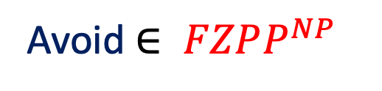
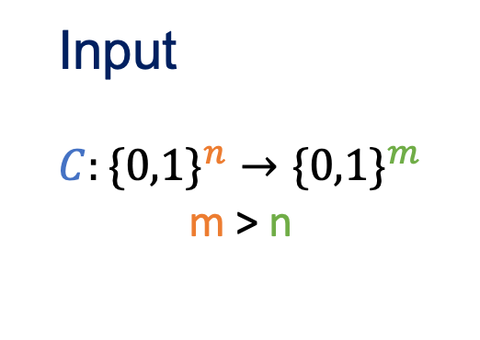

Range Avoidance Problem
[Kleinberg, Korten, Mitropolsky, Papadimitriou 2021]
$$\{0,1\}^{m}$$
Input
$$C:\{0,1\}^{n}→\{0,1\}^{m}$$
m > n
Output
$$y∈{\left\{0,1\right\}}^{m} s.t$$
$∀x C\left(x\right)≠y$
C
$$\{0,1\}^{n}$$
Avoid $∈ FZPP^{NP}$
“Guess and Check”

Slide 6
Deterministic Algorithms for Range Avoid Imply Explicit Constructions
[KKMP 21], [Korten 21]
Hard Truth Tables
Rigid Matrices
Ramsey Graphs
Two Source Randomness Extractors

Slide 7


Avoid Framework for Explicit Constructions
=> Good object
$$Object$$
Succinct Encoding
Decoder (C)
BAD OBJECTS
$$Succinct Encoding$$
Solution to Range Avoid => Object has no Succinct Encoding => not a bad object

Slide 8
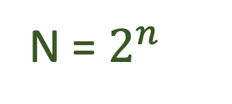
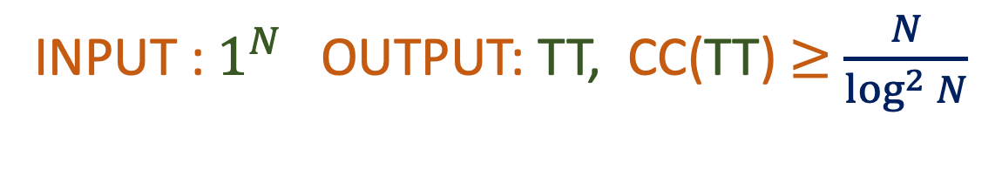
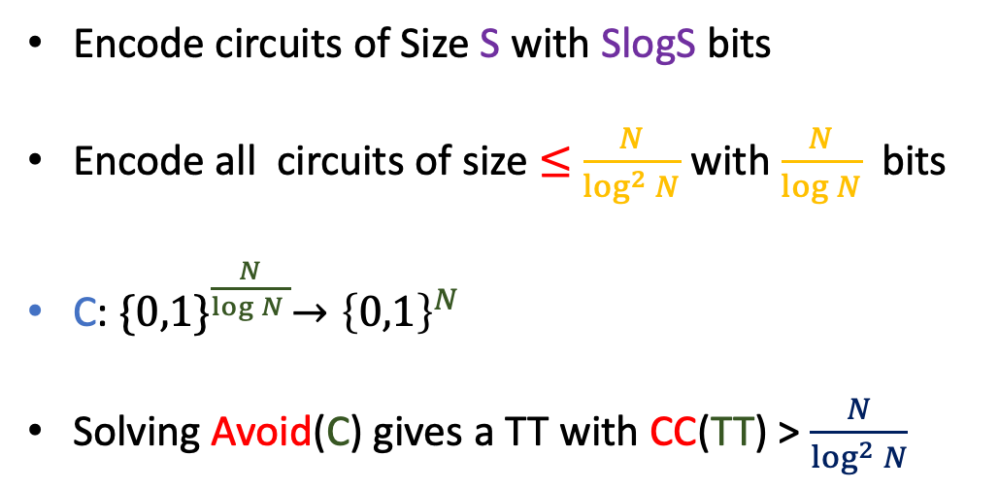

Explicit Construction of Hard Truth Tables
INPUT : $1^{N}$ OUTPUT: TT, CC(TT) $≥$ $\frac{N}{\log^{2}{N}}$
Truth Table with exponential Circuit Complexity
N = $2^{n}$
$$Truth Table of C$$
Encode circuits of Size S with SlogS bits
Encode all circuits of size $≤$ $\frac{N}{\log^{2}{N}}$ with $\frac{N}{\log{N}}$ bits
C: ${\{0,1\}}^{\frac{N}{\log{N} }}→{\left\{0,1\right\}}^{N}$
Solving Avoid(C) gives a TT with CC(TT) > $\frac{N}{\log^{2}{N}}$
Eval C on all inputs
Encoding of C

Slide 9
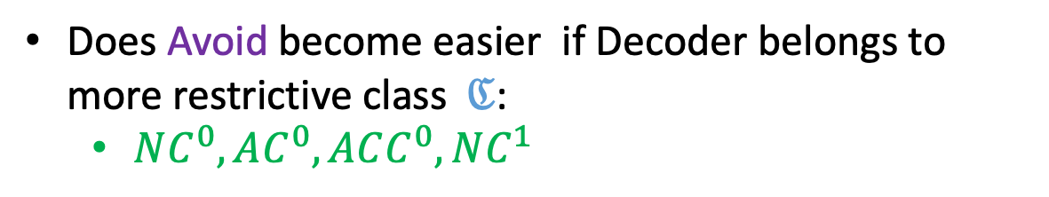




$ℭ$-Avoid
[Ren, Santhanam, Wang 22]
[Guruswami, Lyu, Wang 22]
[Chen, Huang, Li, Ren 23]
No algorithm for Avoid known that is better than brute force
$$\{0,1\}^{m}$$
$$ℭ$$
Does Avoid become easier if Decoder belongs to more restrictive class$ℭ$:
$NC^{0}, AC^{0}, ACC^{0}, NC^{1}$
$$\{0,1\}^{n}$$

Slide 10

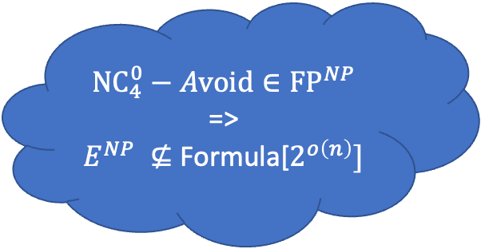
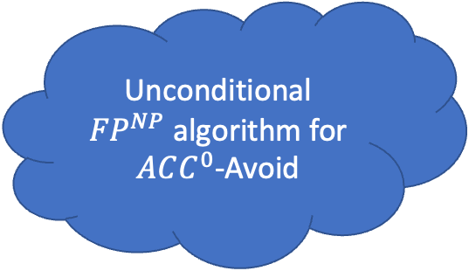
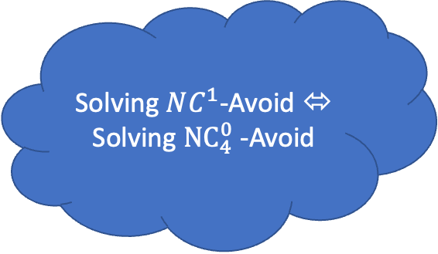
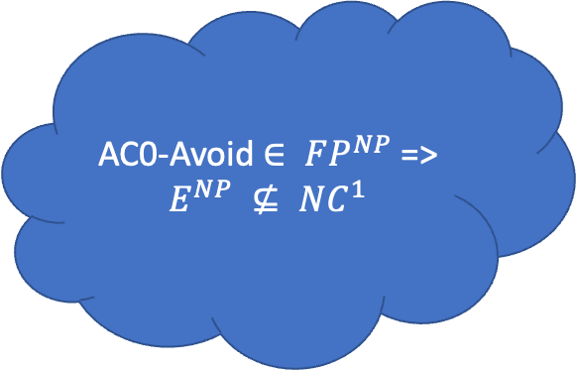
$$ℭ\text{−}\text{Avoid}$$
[Ren, Santhanam, Wang 22]
[Chen, Huang, Li, Ren 23]
Quasi-Poly Stretch
n + o(n) Stretch
AC0-Avoid $∈ FP^{NP}$=>
$$E^{NP} ⊈ NC^{1}$$
Solving $NC^{1}$-Avoid ⬄ Solving ${NC}_{4}^{0}$-Avoid
STRETCH REALLY MATTERS
Randomized Encodings kill stretch
n + o(n) Stretch
Quasi-Poly Stretch
Unconditional ${FP}^{NP}$algorithm for $ACC^{0}$-Avoid
$${{NC}_{4}^{0}−Avoid∈FP}^{NP}$$
=>
$E^{NP} ⊈$ Formula[$2^{o\left(n\right)}]$
Notes:
It seems hard to solve these problems because lowerbounds we believe to be true, but don’t have the toolkit to solve yet

Slide 11
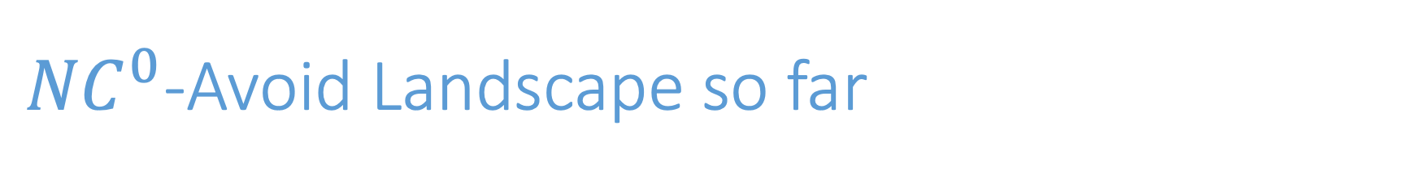

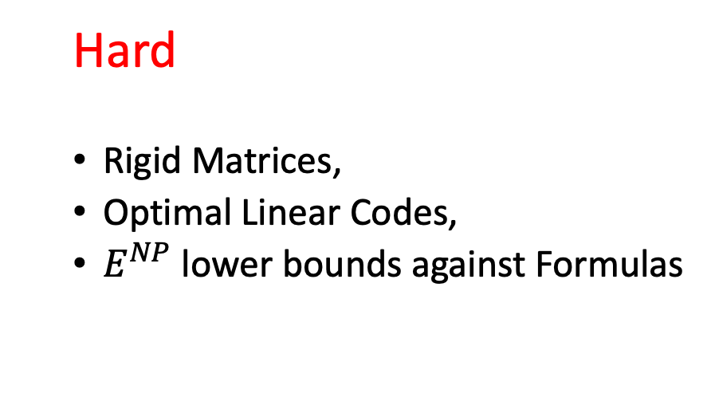
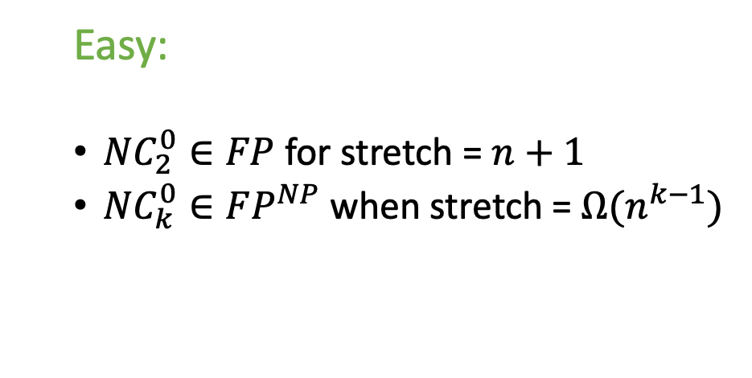
${NC}^{0}$-Avoid Landscape so far
[Ren, Santhanam, Wang 22]
[Guruswami, Lyu, Wang 22]
Hard
Rigid Matrices,
Optimal Linear Codes,
$E^{NP}$ lower bounds against Formulas
Easy:
${NC}_{2}^{0}∈FP$ for stretch = $n+1$
${NC}_{k}^{0}∈FP^{NP}$ when stretch = $Ω(n^{k−1})$
Hardness all seems to lie in $NC_{4}^{0}$-Avoid and beyond
What can we say about ${NC}_{3}^{0}$-Avoid?
Notes:
Fix parameters

Slide 12
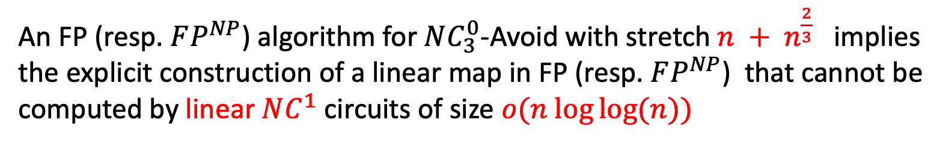
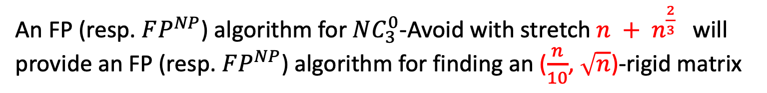
Our Results
HARDNESS
Theorem 1:
An FP (resp. $FP^{NP}$) algorithm for $NC_{3}^{0}$-Avoid with stretch $n + n^{\frac{2}{3}}$will provide an FP (resp. $FP^{NP}$) algorithm for finding an ($\frac{n}{10}$, $\sqrt{n}$)-rigid matrix
Corollary (Valiant):
An FP (resp. $FP^{NP}$) algorithm for $NC_{3}^{0}$-Avoid with stretch $n + n^{\frac{2}{3}}$ implies the explicit construction of a linear map in FP (resp. $FP^{NP}$) that cannot be computed by linear $NC^{1}$ circuits of size $o(n log⁡log⁡(n))$

Slide 13
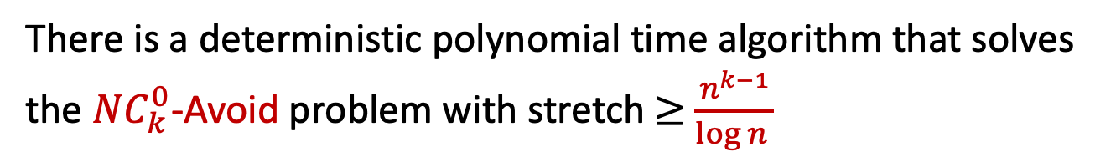
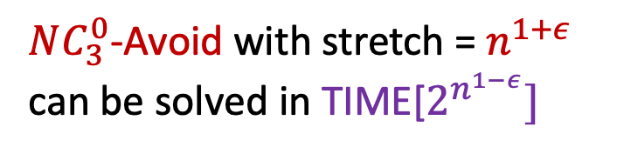
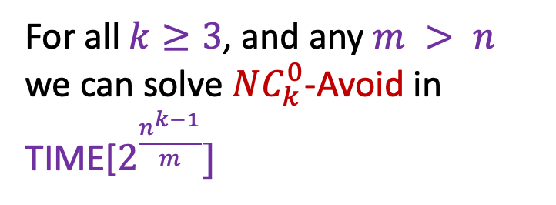
Our Results
ALGORITHMS
Theorem 2:
There is a deterministic polynomial time algorithm that solves the $NC_{k}^{0}$-Avoid problem with stretch $≥$ $\frac{n^{k−1}}{\log{n }}$
Corollary 1:
Corollary 2:
For all $k≥3$, and any $m > n$ we can solve $NC_{k}^{0}$-Avoid in TIME[$2^{\frac{n^{k−1}}{m}}]$
$NC_{3}^{0}$-Avoid with stretch = $n^{1+ε}$ can be solved in TIME[$2^{n^{1−ε}}]$
Notes:
Fix >=

Slide 14
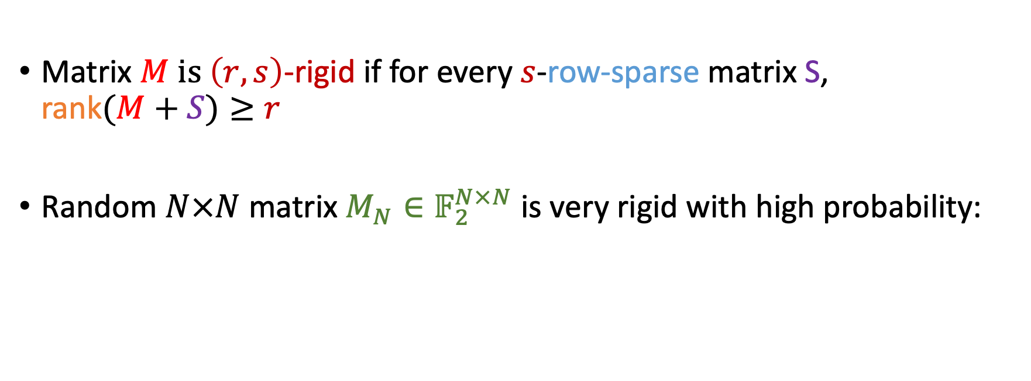

Rigid Matrices
Matrix $M$ $is \left(r, s\right)$-rigid if for every $s$-row-sparse matrix S, rank$(M+S)≥r$
Random $N×N$ matrix $M_{N}∈𝔽_{2}^{N×N}$ is very rigid with high probability:
$M_{N}$ is $(\frac{N}{10},\frac{N}{10})$ -rigid with h.p.
Notes:
Convert to Row-Rigid Notation (Delete all Global Rigidity)

Slide 15
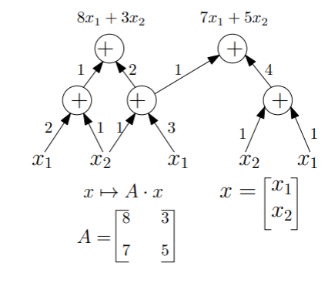

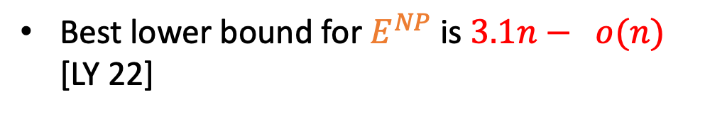
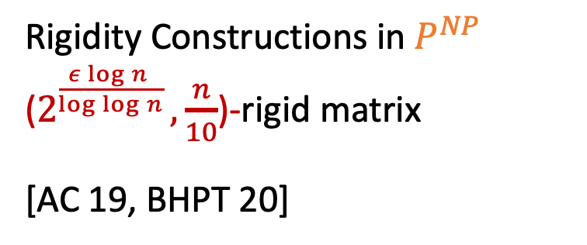
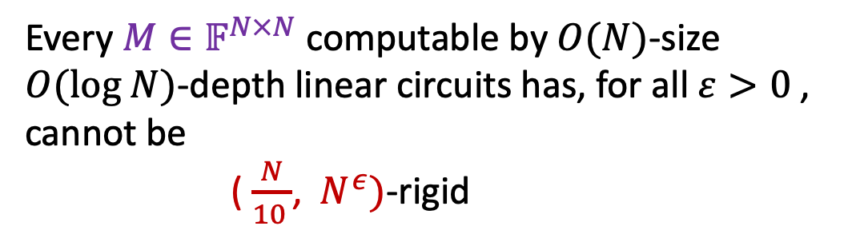
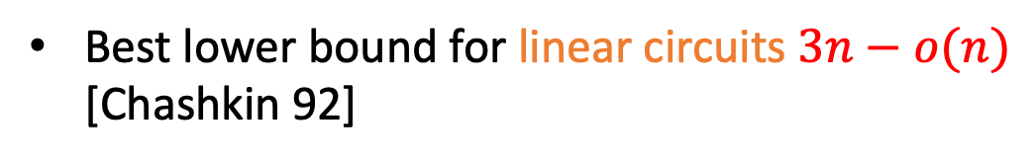
Valiant’s Program
Best lower bound for $E^{NP}$ is $3.1n− o(n)$
[LY 22]
Best lower bound for linear circuits $3n−o(n)$ [Chashkin 92]
Valiant 77:
Rigidity Constructions in${ P}^{NP}$
($2^{\frac{ε\log{n }}{\log{\log{n}}} },\frac{n}{10}$)-rigid matrix
[AC 19, BHPT 20]
Every $M∈𝔽^{N×N}$ computable by $O(N)$-size $O(log N)$-depth linear circuits has, for all $ε>0$, cannot be
( $\frac{N}{10 }$, $N^{ε})$-rigid

Slide 16
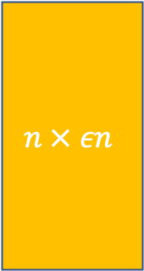

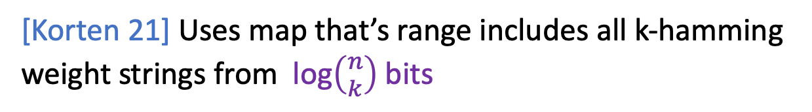
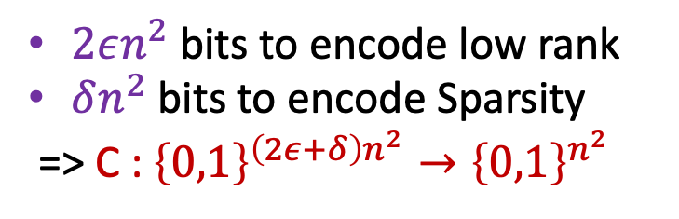

Rigid Matrices
Non-Rigid Matrix = L + S (Low Rank + Sparse)
Non-Rigid
$$n × εn$$
$$εn ×n$$
Sparse
[Korten 21] Uses map that’s range includes all k-hamming weight strings from log$\left({n \atop k}\right)$bits
$2εn^{2}$ bits to encode low rank
$δn^{2}$ bits to encode Sparsity
=> C :${\left\{0,1\right\}}^{\left(2ε+δ\right)n^{2}}→{\left\{0,1\right\}}^{n^{2}}$
[GLW 22] Use Succinct Data structure
Efficient Memory (< $n^{2}$ ), and recovery O(log n) queries

Slide 17
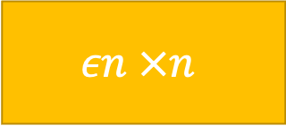
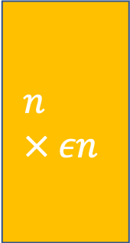
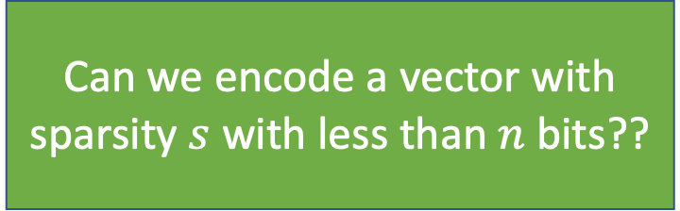
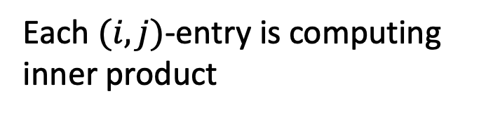
Encoding Non-Rigid Matrices as Degree-2 Polynomials
Non-Rigid = L R + S
$$n × εn$$
$$εn ×n$$
Each $(i,j)$-entry is computing
inner product
Can we encode a vector with sparsity $s$ with less than $n$ bits??
How do we encode Sparsity as degree-2 polynomial?

Slide 18
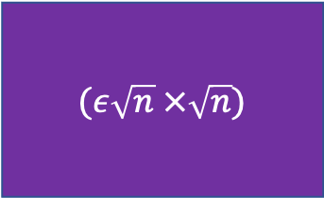
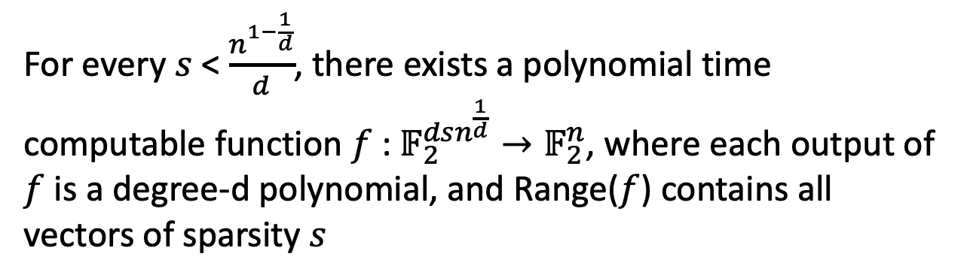
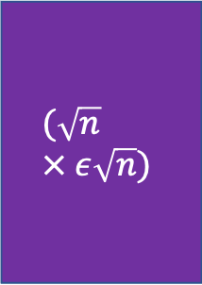
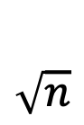

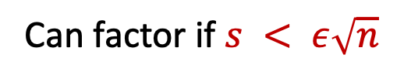
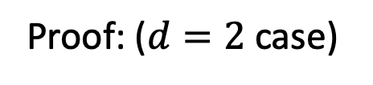
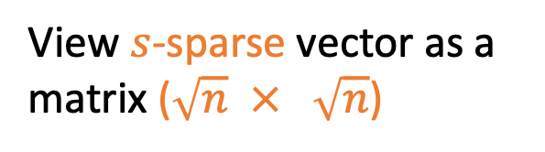
Encoding Non-Rigid Matrices as Degree-2 Polynomials
Lemma:
For every $s$ < $\frac{n^{1−\frac{1}{d}}}{d}$, there exists a polynomial time computable function $f$ : $𝔽_{2}^{dsn^{\frac{1}{d}}}→𝔽_{2}^{n}$, where each output of $f$ is a degree-d polynomial, and Range($f$) contains all vectors of sparsity $s$
Proof: ($d=2$case)
View $s$-sparse vector as a matrix ($\sqrt{n}$ $×$ $\sqrt{n}$)
$$\sqrt{n}$$
$$(\sqrt{n} × ε\sqrt{n})$$
$$(ε\sqrt{n} ×\sqrt{n})$$
$$\sqrt{n}$$
Sparsity provides upper bound on rank
Can factor if $s < ε\sqrt{n}$

Slide 19
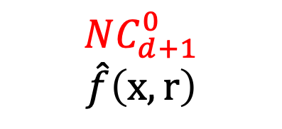

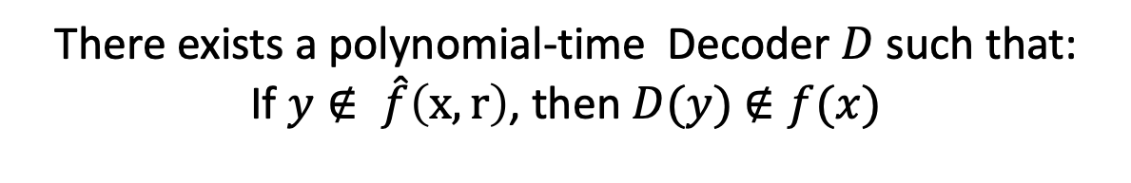
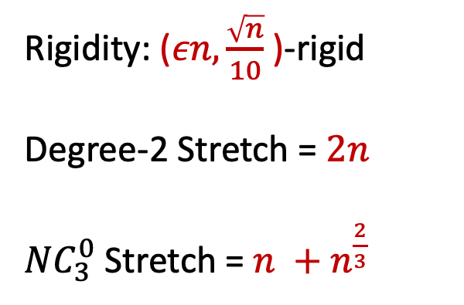
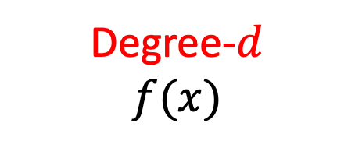
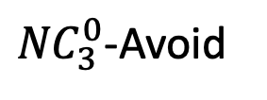
Converting degree-$2$to ${NC}_{3}^{0}$-Avoid
Degree-2-Avoid
${NC}_{3}^{0}$-Avoid
Rigidity: ($εn,\frac{\sqrt{n}}{10}$ )-rigid
Degree-2 Stretch = $2n$
${NC}_{3}^{0}$ Stretch = $n +$ $n^{\frac{2}{3}}$
[AIK 06]
Degree-$d$
$$f(x)$$
$NC_{d+1}^{0}$
$$\hat{f}\left(x,r\right)$$
There exists a polynomial-time Decoder $D$ such that:
If $y∉ \hat{f}\left(x,r\right)$, then $D(y)$ $∉f(x)$
Rigidity =>
Super-linear Lower bound
Notes:
Guruswami gets better parameters

Slide 20

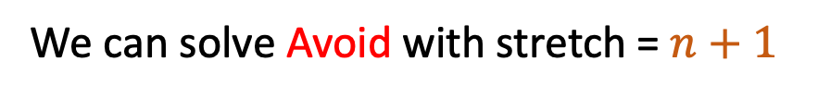

Framework for Algorithms for ${NC}_{k}^{0}$-Avoid
What if we had a #SAT Oracle?
Each output bit defines a CNF with $2^{k}$-clauses
Use #SAT oracle to figure out which assignment shrink number of satisfying inputs
After n steps at most 1 remaining input
We can solve Avoid with stretch = $n+1$
#SAT too expensive
Try simulating same idea via affine subspaces
Notes:
#SAT-ORACLE could solve it exactly

Slide 21

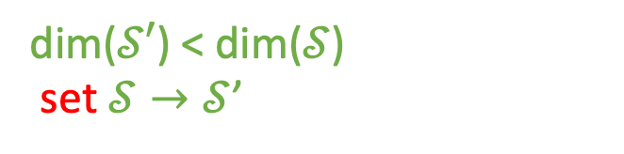
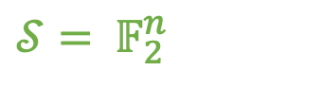
Linear Algebra Framework for ${NC}_{k}^{0}$-Avoid
y = (*,*,*, …….,*,* )
$𝒮=$ $𝔽_{2}^{n}$
y = (*,1,*,0,0,*, *)
dim($𝒮′$) < dim($𝒮$)
set $𝒮→𝒮$’
If dim($𝒮$)=0 => Solution for Avoid
Tradeoff #SAT-Oracle with bigger stretch

Slide 22














Warmup: ${NC}_{3}^{0}$-Avoid with stretch $n^{2}$
$$y_{1}$$
$y_{2}$
$n$ pairs of outputs that both depend on same pair of inputs
There exists $c_{1},c_{2}$ s.t. $y_{1}=c_{1}, y_{2}=c_{2}$ has at most 4 satisfying assignments of $x_{1},x_{2},x_{3},x_{4}$
$$x_{1}$$
$$x_{2}$$
$$x_{3 }$$
$$x_{4}$$
Can define 3-dimensional Affine Subspace over 4 points in $𝔽_{2}^{4}$.
$ℋ→$ hyperplane over $𝔽_{2}^{4}$
$ℋ^{′}→$Extend $ℋ$ to $𝔽_{2}^{n}$
Improve GLW (no use of NP oracle!!!!)
Case 1: If $𝒮⊈$ $ℋ^{′}$
$dim⁡(𝒮∩ℋ^{′}$) < dim($𝒮$)
Limitation: Affine Subspace seems too restrictive
Case 2: If $𝒮⊆$ $ℋ^{′}$
Also easy
How about Union of Affine Subspaces???

Slide 23


Sketch for ${NC}_{3}^{0}$-Avoid with stretch $\frac{n^{2}}{\log{n}}$
Pick dense subset of log n inputs (I) that will map to $3n$ outputs (O)
Dense Input Lemma
Maintain an affine subspace for each possible assignment to I
At step $i$, set $o_{i}∈O$ to b
Total Size of Disjoint Union Decreases by some constant factor
Dimension Reduction Lemma
After 3n steps size of disjoint union is 0

Slide 24







Dense Input Lemma
Lemma (Generalizes for $NC_{k}^{0})$:
There are $t$ inputs that map to $3n$ outputs such that each of the $3n$ outputs depend on at least one of the $t$ inputs. Moreover, we can find this collection of $t$ inputs and $3n$ outputs in polynomial time
Consider Bipartite Graph over inputs and outputs
$$output$$
Degree = 3m, Average degree per input = $\frac{3m}{n}$
Pick t input nodes with highest degree, and look at corresponding output set
Parametrizing t,m: $t=\frac{n^{2}}{m}$
$$input$$

Slide 25


Affine Reduce (${NC}_{2}^{0}$-Avoid)
Lemma (Dimension Reduction Lemma):
Let $𝒮⊆ 𝔽_{2}^{n}$ be an affine subspace and $f$, a function that depends on two inputs, there is a polynomial time algorithm that finds two subspaces $𝒮_{0},𝒮_{1}⊆ 𝒮$ such that:
$∀ x∈𝒮, b∈\left\{0,1\right\},$ if $f\left(x\right)=b$, then $x∈𝒮_{b}$
|$𝒮_{0}$| + |$𝒮_{1}$| $≤\frac{3\left|𝒮\right|}{2}$
Case 1: $f\left(x\right)=c$ [Constant Function]
Case 2: $f\left(x\right)=a_{1}x_{1}+a_{2}x_{2}+c$ [Affine Function]
Case 3: $f\left(x\right)=\left(x_{1}+a_{1}\right)\left(x_{2}+a_{2}\right)+c$ [Quadratic Function]

Slide 26








${NC}_{2}^{0}$-Avoid with stretch n+1
Corollary:
There is a deterministic time polynomial time algorithm that solves $NC_{2}^{0}$-Avoid with stretch = $n+1$
Set y = (*, *, …, *)
$$𝒮= 𝔽_{2}^{n}$$
For $i=1→n$
Apply Dimension reduction Lemma on $y_{i}$
$${𝒮_{b}=min⁡(𝒮}_{0, }𝒮_{1})$$
After $n$ steps, dim($𝒮)=0$
Update $y_{i}$ = b, $𝒮$= $𝒮_{b}$

Slide 27







${NC}_{3}^{0}$-Avoid with stretch $\frac{n^{2}}{\log{n}}$
I, O = $log n$ inputs mapping into $3n$ outputs
$a_{j} ←$ Assignment to I
$𝒰_{a_{j}}←$ Affine Subspace defined by $a_{j}$
Restricted on O, instance of $NC_{2}^{0}$-Avoid
$$𝒮=\bigcup_{a_{j}}{𝒰_{a_{j}}}$$
y = (*, *, …, *)
Disjoint Union of Affine Subspaces
Solve OR of $NC_{2}^{0}$-Avoid

Slide 28













${NC}_{3}^{0}$-Avoid with stretch $\frac{n^{2}}{\log{n}}$
$$𝒮=\bigcup_{a_{j}}{𝒰_{a_{j}}}$$
Corollary :
y = (*, *, …, *)
$NC_{3}^{0}$-Avoid with stretch = $n^{1+ε}$ can be solved in TIME[$2^{n^{1−ε}}]$
$$𝒰_{a_{j}}^{0}←set y_{i}=0$$
$$𝒰_{a_{j}}^{1}←set y_{i}=1$$
$$\sum_{a_j}{𝒰_{a_{j}}^{0}}$$
$$\sum_{a_j}{𝒰_{a_{j}}^{1}}$$
$$\frac{3}{2}\sum_{a_j}{𝒰_{a_{j}}}$$
$\frac{3}{2}$ |$𝒮$|
+
$$≤$$
$$≤$$
Dimension Reduction Lemma
$$\sum_{a_j}{𝒰_{a_{j}}^{b} ≤\frac{3}{4}|S|}$$
Choose b, s.t.
Set $y_{i}=b,{ 𝒰}_{a_{j} }$= ${ 𝒰}_{a_{j}}^{b}$
After $\log_{\frac{4}{3}}{n≤3n }$ steps | $𝒮$| = 0
y is a solution to Avoid

Slide 29


Open Questions
1) Are there more explicit constructions in Degree-$2$ or $NC_{3}^{0}$-Avoid ?
Linear Codes?
2) Avenue for Explicit Construction of Rigid Matrices
Solving ${NC}_{3}^{0}$-Avoid with stretch $n + o(n)$ in time $2^{\sqrt{n}}$ (with NP oracle)
=> Explicit construction of rigid matrices in E (resp. $E^{NP}$)
3) Is degree-$2$ Avoid an easier problem ?
$Ω\left(n^{2}\right)$is easy, $Ω\left(n^{\frac{4}{3}−ε}\right)$ give better rigidity than AC[19], BHPT[19]
4) Can we use NP-oracle in some nice way to reduce the stretch ?
5) Is there some conditional lower bound on stretch = $Ω\left(\frac{n^{2}}{\log{n }}\right)$ for FP for ${NC}_{3}^{0}$-Avoid

Slide 30
Thanks !!!!!

